Slide 1
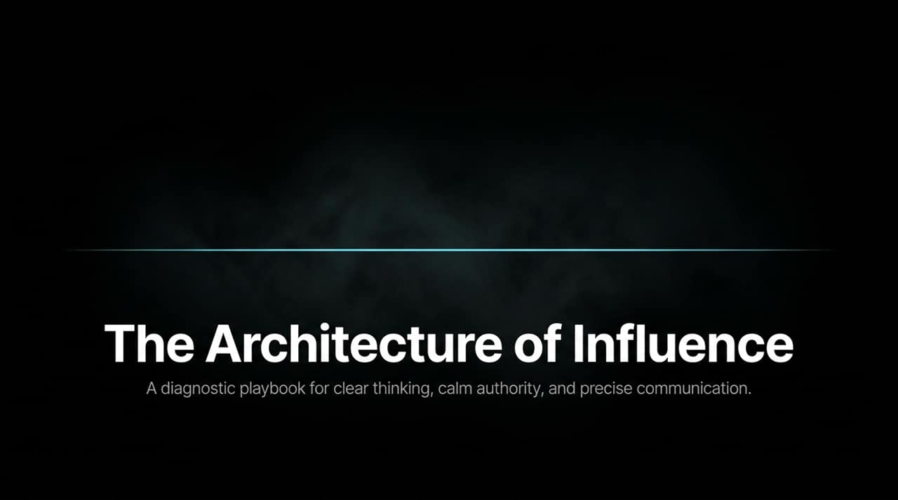
Notes:
Welcome, everyone. Today, we are discussing The Architecture of Influence: A Diagnostic Playbook for Clear Thinking, Calm Authority, and Precise Communication.
There’s a fundamental truth that many professionals avoid facing: if others do not feel clarity, strength, and certainty in your voice, they will not trust you, follow you, or take action because of you. You can hold brilliant ideas and years of deep experience, but if the way you think and speak fails to reflect that, your true impact remains invisible.
Real influence is not about sounding artificially smooth or speaking louder than everyone else in the room. True influence is an engineered outcome built from the inside out. As shown on this slide, it moves through concentric layers:
The Inner Game: Mastering your internal mind, emotion, and nervous system.
The Mechanics: Structuring your words, language, and message with surgical precision.
The Dynamics: Reading the climate of the room and aligning with its energy.
The Eternal: Achieving true mastery through deliberate, continuous repetition.
Remember this core principle throughout our session today: When you change the way you speak, you change your identity. Let’s explore how to refine your voice into a true tool of leadership.
https://www.youtube.com/watch?v=EScIzEExWWE

Slide 2
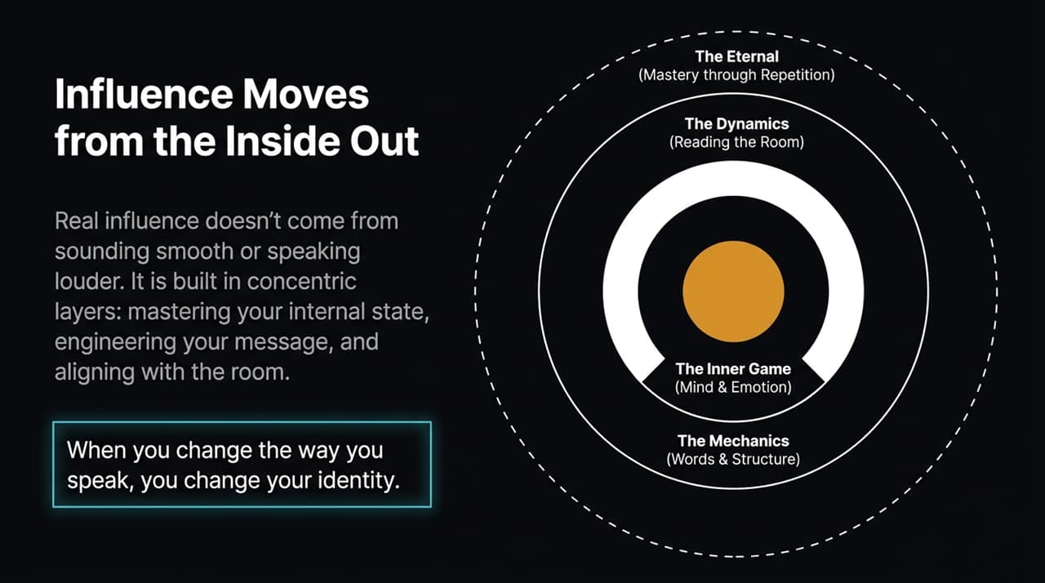
Notes:
Let's turn to Slide 2: Communication Starts in the Silence.
Most people assume that communication begins the second their mouth opens. In reality, high-stakes communication begins in the silence before the first word. It starts in that crucial space where you gather your thoughts, filter your noise, and align your intention.
Here lies The Trap of Simultaneous Processing: The human mind is simply not built to think, filter, refine, and deliver a complex thought all at the same time. When you try to organize your thoughts while actively speaking, you fall into a destructive cycle—talking faster out of uncertainty, over-explaining because the initial point was weak, and ultimately under-delivering.
To break this trap, we must embody The Discipline of Clarity. Clarity requires slowing down. Slowing down doesn't mean thinking less; it means thinking better. It gives your mental desk space to separate the signal from the surrounding noise. You must strip away the emotional debris and locate the absolute core of your idea.
As you see at the bottom of the slide, we use The Ultimate Test: If you cannot express your point in one clean sentence, your mind hasn't finished thinking yet. Never inflict your unformed thoughts on your audience—filter in the silence first.

Slide 3
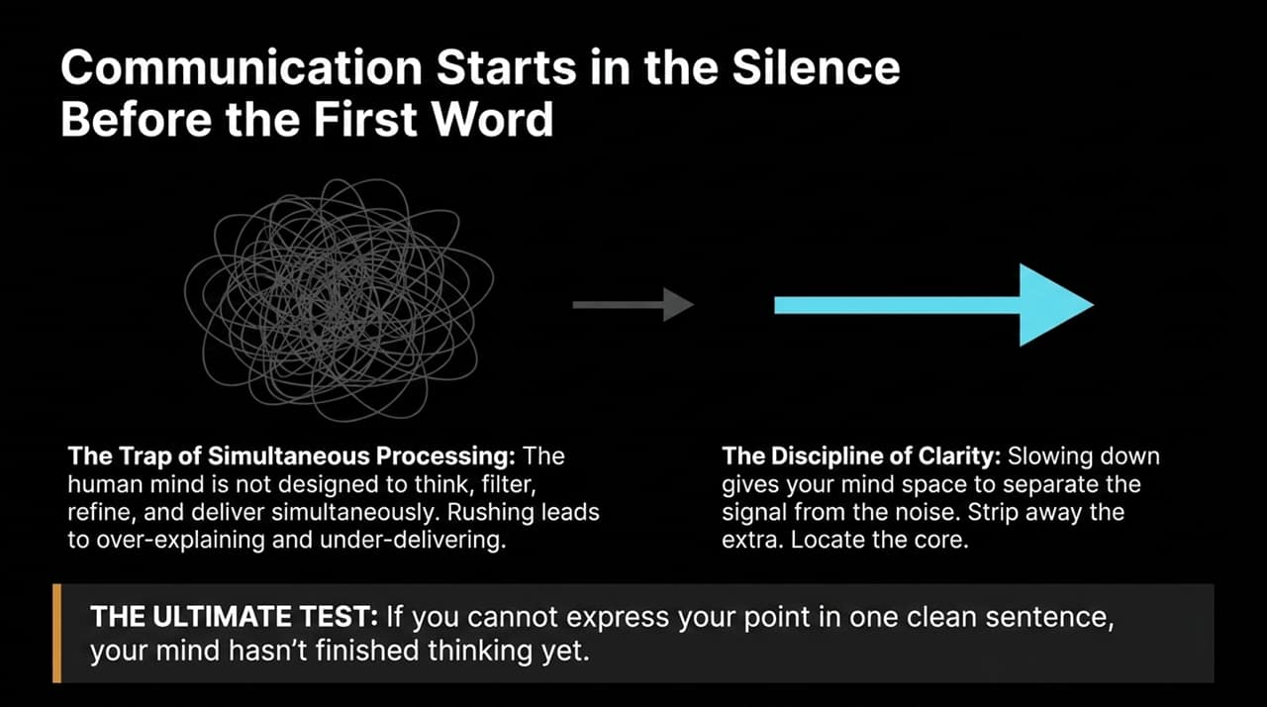
Notes:
Moving to Slide 3, we look at a critical leadership capability: Decoupling Emotion from Delivery.
Emotional noise is one of the greatest barriers to persuasive thought. Fear of judgment or feelings of frustration push people into reactive delivery. But mature communication requires separating what you feel from what you mean. Feelings create noise; meaning creates clarity.
Look at the diagnostic table on this slide comparing Reactive vs. Controlled Delivery:
When feeling Frustrated or Challenged: A reactive communicator speaks with fast pacing, a tight high pitch, and defensive language. This immediately spikes tension in the room. A controlled leader adopts a slow pace, selects precise words, drops into a low vocal register, and stabilizes the room.
When feeling Anxious or Uncertain: The reactive speaker uses rushed, trailing sentences, heavy filler words, and endless over-explanation—signaling internal fragility. Conversely, the controlled speaker uses intentional pauses, grounded breathing, and isn't afraid to state a clear 'I don't know', signaling safety and composure.
You can feel frustrated or challenged internally while still speaking with absolute precision externally. The moment you separate your inner emotion from your external delivery, you reclaim total command over the room.

Slide 4
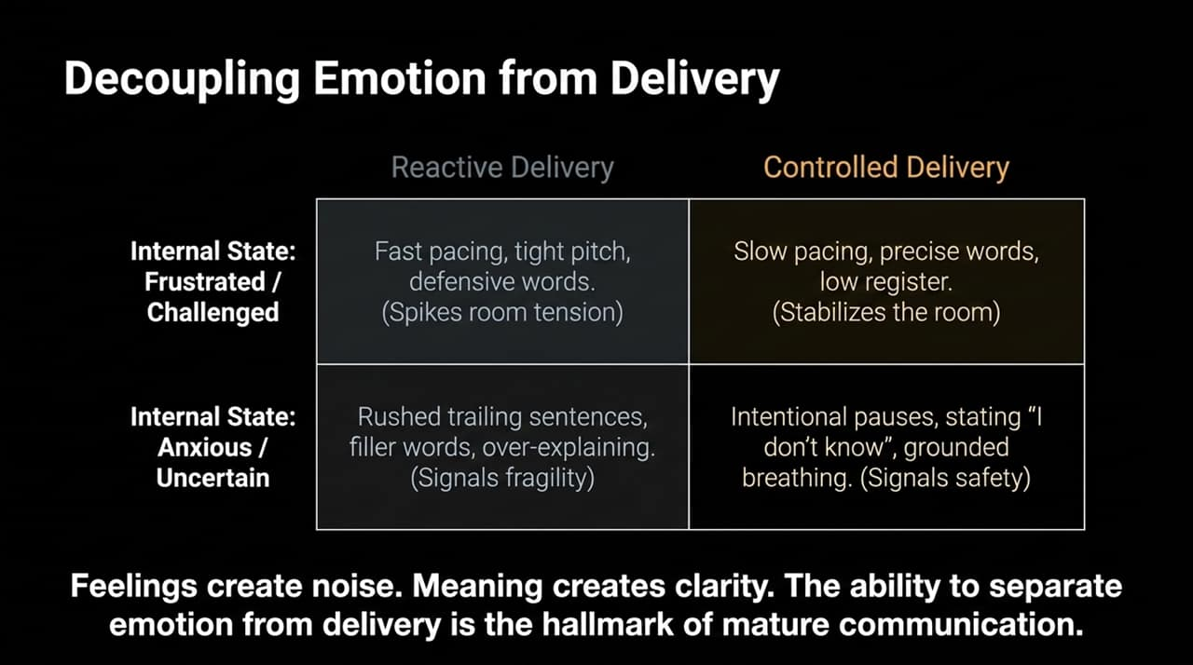
Notes:
Slide 4 challenges a common myth: Authority is Presence, Not Volume.
Many people assume that authority requires talking louder, faster, or with aggressive intensity. But intensity without clarity creates pressure, not confidence. True authority comes from calm stability.
Let's look at the three foundational pillars of calm authority:
The Grounded Register: Speed communicates anxiety; stability communicates authority. When you slow your cadence down, your voice naturally settles into a low, steady register that commands respect.
The Breathing Baseline: Your voice is the billboard for your nervous system. When your breathing is shallow, your voice becomes thin and shaky. Steady, deep breathing grounds your physiology and drops your vocal tone into a place of natural confidence.
The Absorption of Tension: Calmness is an active force, not a passive state. In high-stakes, tense moments, a grounded voice acts like a sponge—absorbing room tension and reassuring everyone that the situation is completely manageable.
Remember this principle: People don't follow the loudest voice in the room. People follow the most stable one.

Slide 5
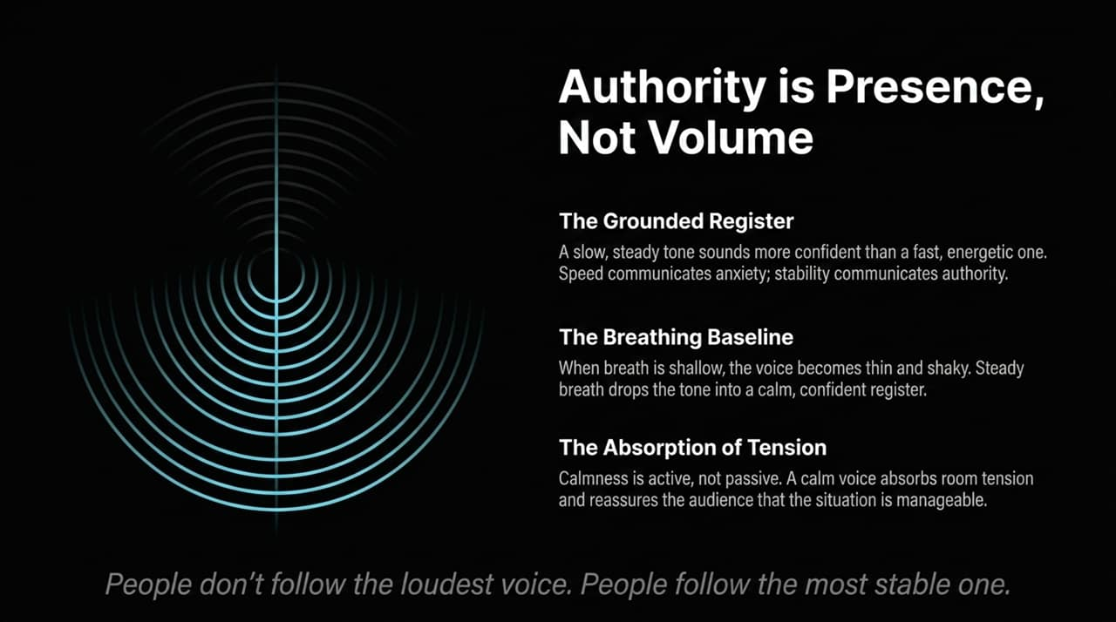
Notes:
Slide 5 is a self-diagnostic framework. Ask yourself honestly right now: Where do you fall between 'The Reactive Talker' and 'The Calm Leader'?
Let's analyze the three diagnostic dimensions:
Voice & Pace: The Reactive Talker speeds up during moments of tension; their pitch becomes high, rushed, and strained. The Calm Leader slows down when tension spikes, maintaining a steady rhythm and grounded vocal register.
Word Choice: The Reactive Talker relies heavily on softeners like 'maybe', 'I guess', and 'sort of', using filler words to avoid direct accountability. The Calm Leader uses sharp, precise verbal tools, ruthlessly eliminating clutter.
Use of Silence: The Reactive Talker panics during quiet moments, filling space with noise because they fear silence will make them look unprepared. The Calm Leader uses silence strategically as a framing tool to give their message gravity and depth.
Ultimately, it comes down to Focus: The Reactive Talker speaks merely to be heard and understood. The Calm Leader speaks intentionally to lead, inspire confidence, and drive decisive action.

Slide 6
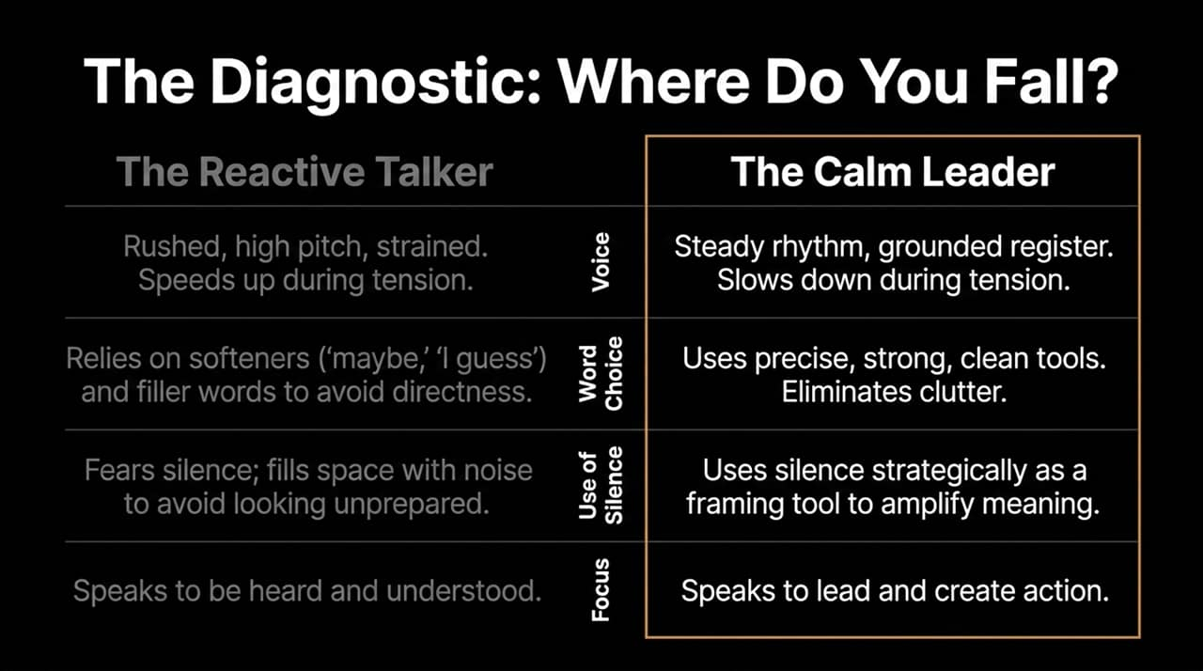
Notes:
Turning to Slide 6: Weak Words Create Weak Influence.
Words are not decorative elements in communication; they are leverage. Your language acts as the thermostat of your personal power. Weak words create weak influence; strong, precise words create strong influence.
Notice the visual shift on this slide:
The Softening Trap: Statements like "I think this might sort of be the right direction..." instantly erode your credibility. It signals to your audience that you are ungrounded and unsure of your own stance.
The Leadership Cut: Replacing that weak language with "Here is the direction we should take" immediately anchors the room and instills confidence.
Many professionals soften their language because they fear sounding overly direct or rude. But directness is not rudeness—directness is clarity, and clarity is a gift to your listeners.
Pay close attention to the identity feedback loop: When you habitually use uncertain words, you eventually become an uncertain person. Raise your language, and you raise your identity.

Slide 7
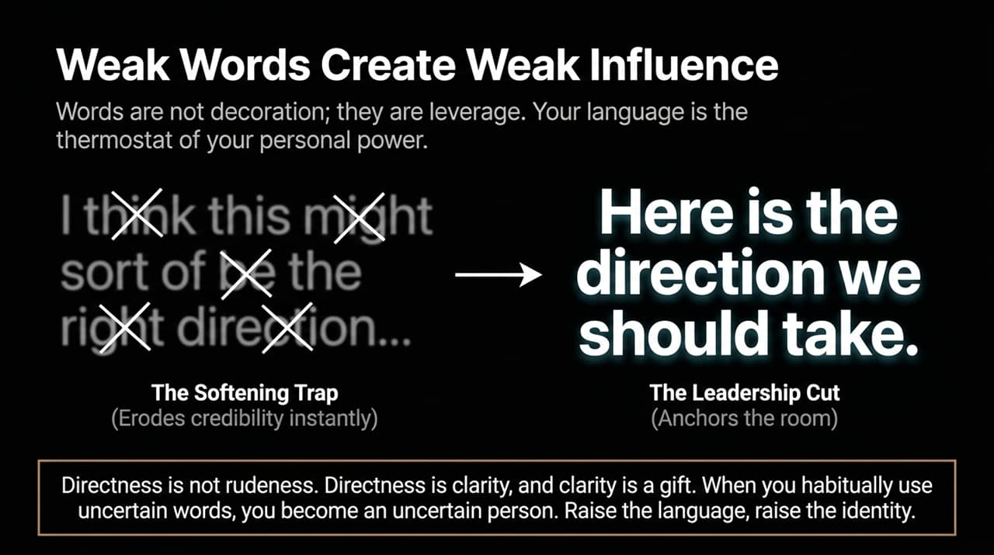
Notes:
On Slide 7, we examine the structural framework of executive messaging: The Spine of a Message.
Leadership is not just about what you say, but the structural backbone behind what you say. A message without a spine is just noise. To ensure your points land with weight, route your ideas through The Message Pipeline:
Anchor (The Point): Start here immediately. No lengthy backstories, no long warm-ups. Lead directly with your core point to ground the listener right away.
Context (The Support): Provide just enough reasoning, data, or examples to illuminate the point. Restraint is crucial here—too many details dilute the impact.
Gravity (The Pause): After delivering the point and support, stop speaking. The pause allows the message to lock into the listener's mind and signals that what you just said carries weight.
Momentum (The Direction): Conclude by outlining the immediate next step. This transforms abstract understanding into tangible movement.
Structure brings liberation from chaos and commands immediate professional trust.

Slide 8
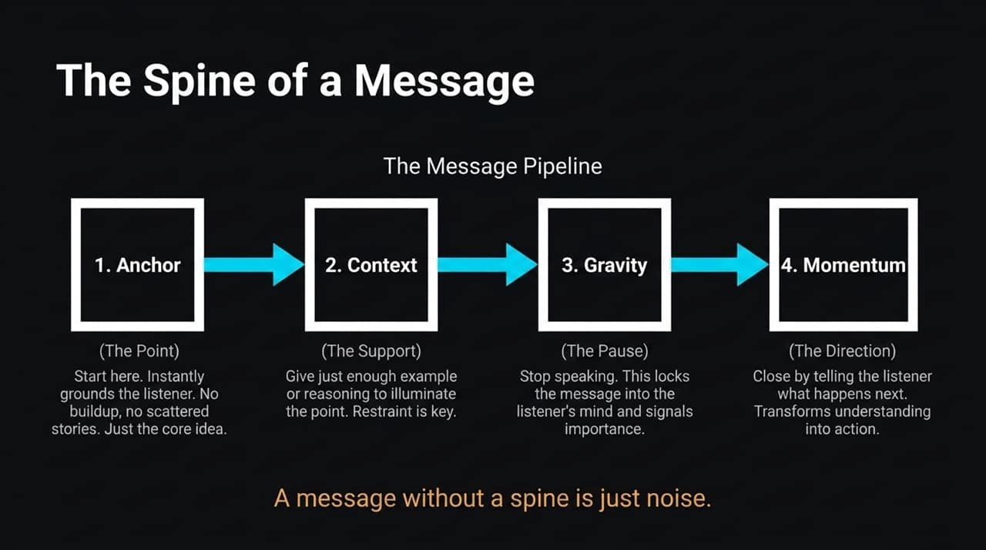
Notes:
Slide 8 addresses a major gap in professional communication: Speak to Activate, Not Just Explain.
There is a massive difference between a communicator and an influencer. A communicator merely shares information; an influencer creates momentum. Understanding is not action, and head-nodding in a meeting is not true commitment. Ideas rarely fail because they are bad—they fail because they remain general and abstract.
Look at the funnel on this slide:
General Understanding & Agreement: This is where most presentations stall. Everyone agrees in theory, but no one takes ownership.
Clear Direction (Shrinking the Step): People hesitate when the required action feels overwhelming or vague. True leadership is the art of shrinking the step until it feels completely doable, removing all friction to motion.
Momentum & Action: Close with decisive commands like "Here is our next move". When you provide clear, confident direction, you remove their fear of choosing and lend them your courage to act.

Slide 9
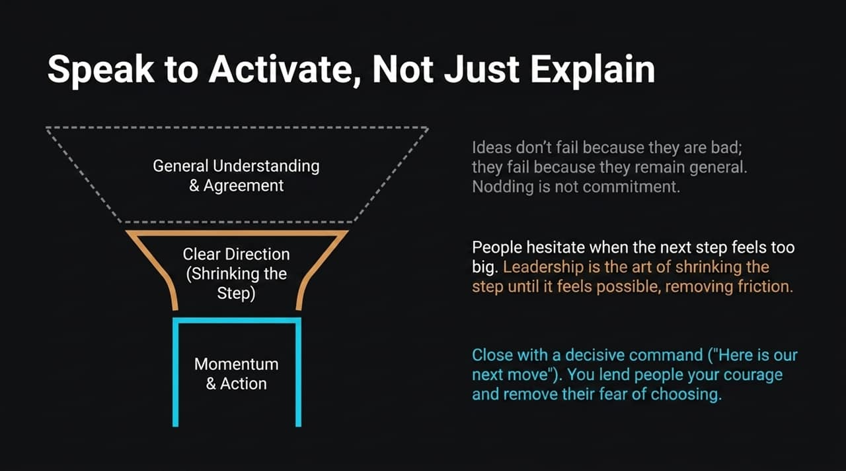
Notes:
Slide 9 highlights our most underutilized communication asset: Silence is Not Empty. It is Emphasis.
As illustrated by the visual wave comparison on the slide, continuous streams of talking create a flat, exhausting blur where no single point stands out. Strategic silence creates depth, contrast, and gravity.
Consider two core functions of silence:
The Amplifier: Silence acts like the frame around a fine painting. A pause before a key point creates anticipation; a pause after a key point creates impact and gives the mind room to absorb meaning.
The Emotional Anchor: In tense or heated moments, staying silent prevents chaotic escalation. It shifts power directly from the reactive person to the grounded person. It non-verbally communicates: "I will not enter your chaos; I control the cadence here."
Always remember: The person who controls the silence controls the room.

Slide 10
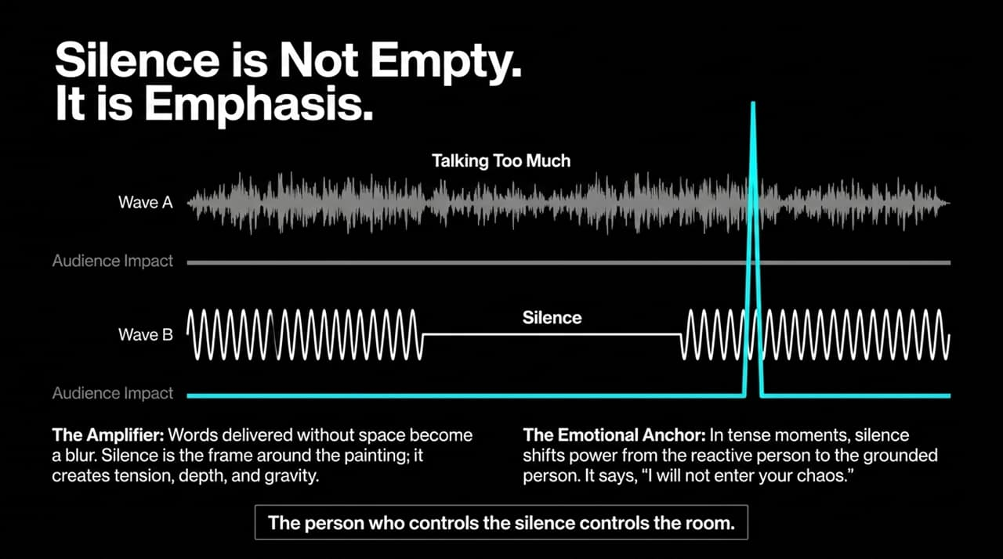
Notes:
Let's turn to Slide 10: Surf the Energy of the Room.
You can deliver a flawless sentence, but if the room isn't ready to receive it, your message falls flat. Influence requires alignment with room dynamics. You cannot lead a room that you cannot feel.
We utilize The Alignment Radar through two steps:
Observation before Participation: People communicate with their physical bodies long before they speak. Pay close attention to posture, seating arrangements, breathing patterns, and room climate before you deliver your message.
Dynamic Calibration: You must adjust your three core speaker dials—Pace, Tone, and Directness—based on the room climate:
If the room is Tense: Dial back your speed, lower your vocal pitch, and provide grounded reassurance.
If the room is Restless or Skeptical: Tighten your structure, increase directness, and strike straight at the core facts.
Adaptation is not weakness—it is supreme mastery. Think of communication like surfing: push aggressively against the wave and you crash; ride its natural energy and you glide.

Slide 11
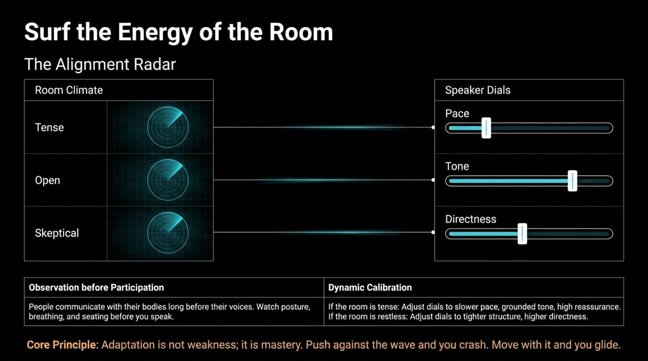
Notes:
Slide 11 focuses on the core currency of long-term influence: Trust is Built on Precision and Honesty.
Without trust, no amount of charisma, slick delivery, or clever structure will move people. Trust is established or destroyed through precision and absolute honesty.
Let's break down the three rules on this slide:
Precision as Respect: Vague statements feel slippery and create suspicion; precise statements feel solid and safe. Specificity eliminates guesswork and shows your audience that you respect their time.
The Power of 'I Don't Know': Counterintuitively, stating 'I don't know' with calm composure carries massive weight. It signals to everyone that you refuse to pretend or guess, making everything else you state far more credible.
The Rule of Reality: Say only what you can stand behind. Avoid inflating claims or speaking in absolutes when facing genuine uncertainty.
Honesty does not weaken your authority—it deepens your credibility and creates emotional safety for your team.

Slide 12
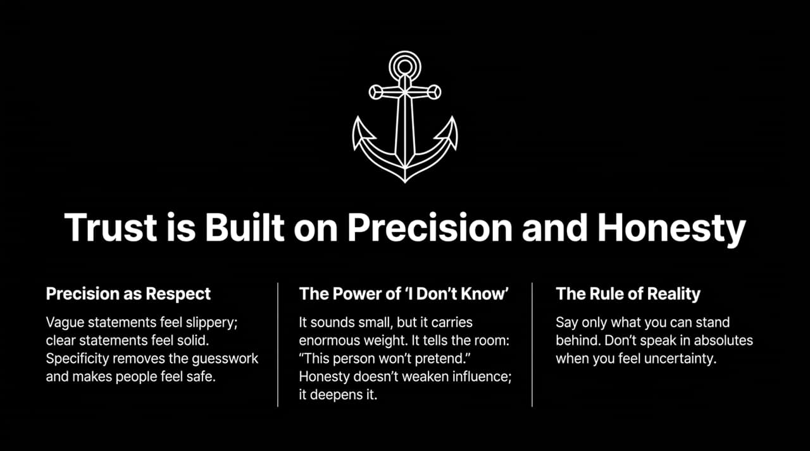
Notes:
Slide 12 brings our concepts together in The Equation of Influence.
As the Venn diagram illustrates, true influence is not an accidental byproduct of raw charisma. It is an engineered outcome that occurs at the precise intersection of three distinct domains:
Grounded Internal State: Inner calm, emotional control, and controlled breathing.
Razor-Sharp Words: Clean structure, strong vocabulary, and direct language free of fluff.
Sensory Alignment: Reading room climate, calibrating pace, and using strategic pauses.
When these three elements converge, your presence becomes truly undeniable.
Look at The Ultimate Truth at the bottom of the slide: You are not just improving a communication skill. You are refining your identity. The voice you bring into the world is the doorway through which people understand your mind.

Slide 13
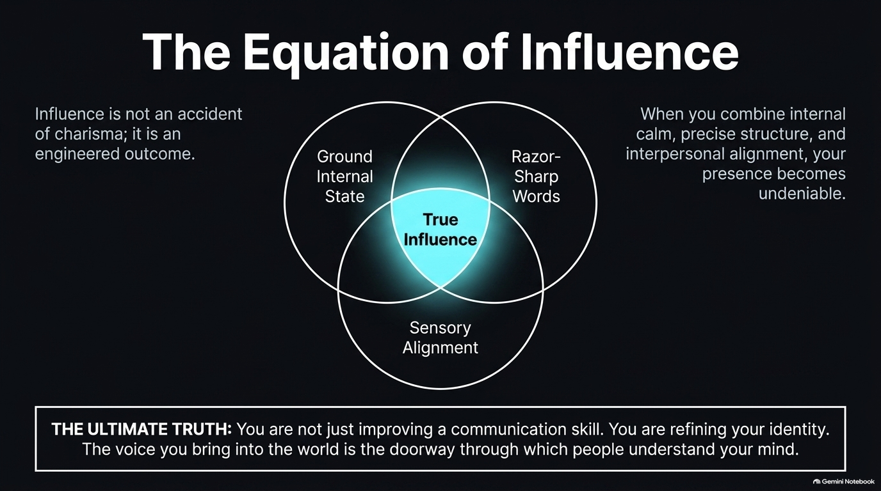
Notes:
Slide 13 provides a visual comparative contrast between the two paths of professional communication: The Talker (Reactive) versus The Leader (Influential).
Let's look at the foundational split across the three critical dimensions:
Preparation: The Talker thinks while speaking, resulting in scattered ideas and rambling explanations. The Leader thinks before speaking, utilizing silence to filter thoughts into a clear point.
Word Choice: The Talker explains endlessly just to be understood, burying their point under noise. The Leader speaks concisely to lead and spark action.
Use of Silence: The Talker fills every gap out of fear and insecurity. The Leader intentionally employs pauses to create gravity, authority, and emphasis.
Notice the core framework for action at the top: Structure with a Spine, Master the Emotional Tone, and Close with Direction. This visual contrast serves as a daily benchmark for how we choose to present ourselves.

Slide 14
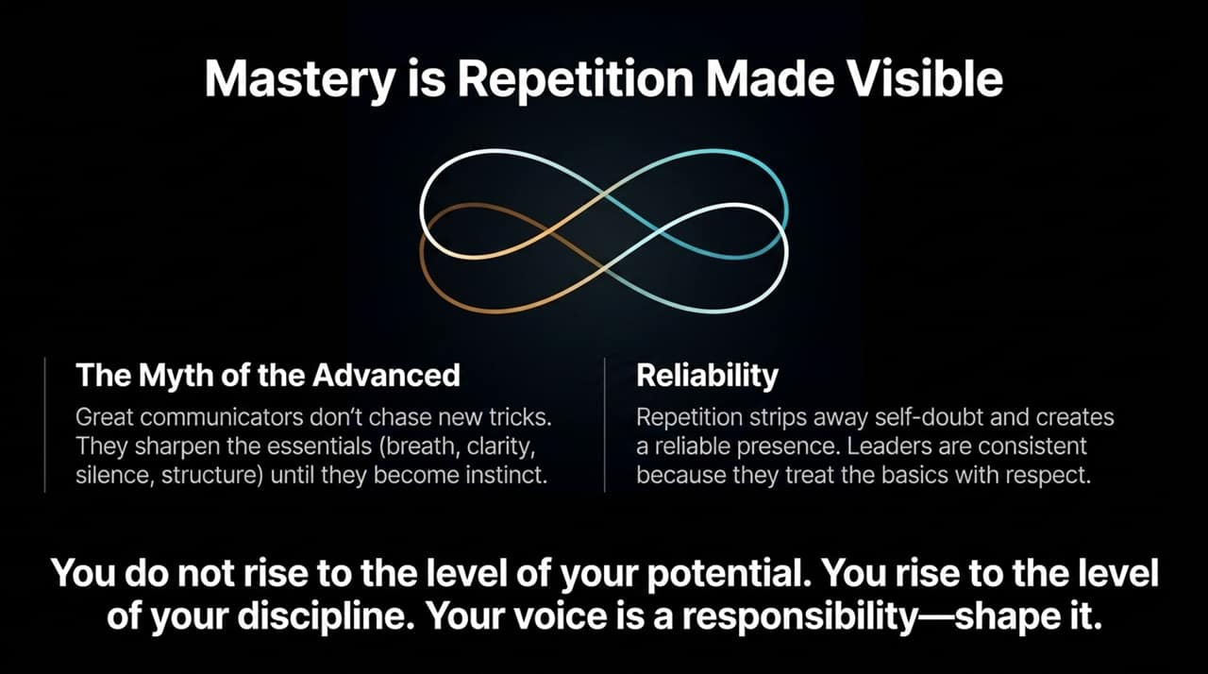
Notes:
Turning to Slide 14: Mastery is Repetition Made Visible.
How do we translate these principles into permanent capabilities? We must dispel The Myth of the Advanced. Exceptional communicators do not constantly chase novel tricks or complex techniques. Instead, they sharpen the fundamental basics—breath, clarity, silence, structure—until those basics become pure instinct.
Repetition strips away hesitation, self-doubt, and mental clutter, building Reliability. Leaders are consistently effective because they treat the basics with immense respect every single day.
Take this core principle to heart: You do not rise to the level of your potential. You rise to the level of your discipline. Your voice is a responsibility—shape it with daily practice.

Slide 15
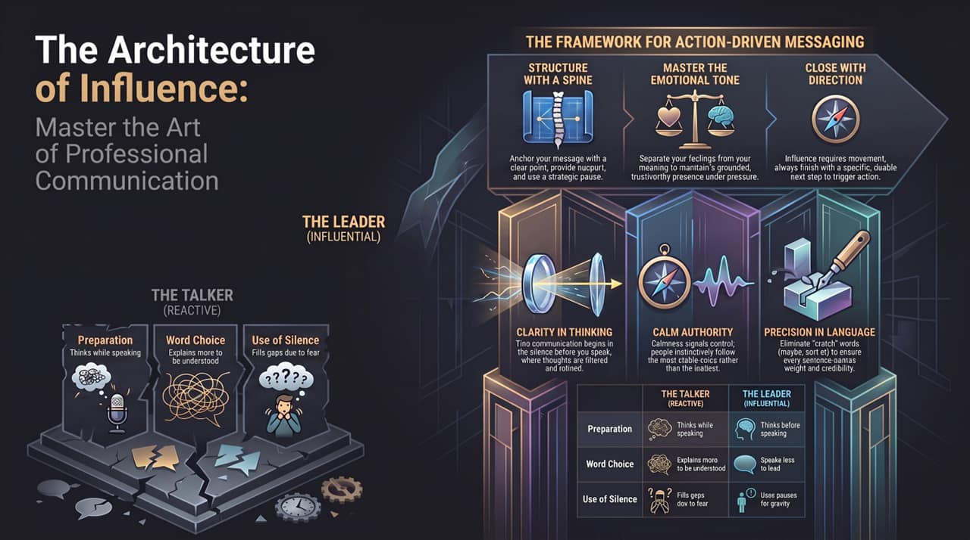
Notes:
Slide 15 consolidates our diagnostic comparisons into three clear, actionable pillars of professional excellence:
Clarity in Thinking: True communication begins in the silence before you speak, where thoughts are filtered, refined, and reduced to their essential core.
Calm Authority: Calmness signals absolute control. In moments of corporate tension or uncertainty, people instinctively follow the most stable voice, not the loudest or most aggressive one.
Precision in Language: Eliminate crutch words like 'maybe', 'I guess', or 'sort of'. Ensuring every sentence carries weight builds immediate credibility.
As shown in the reference matrix, every daily interaction gives you a choice: Will you react like 'The Talker' or respond with the grounded precision of 'The Leader'?

